Slide 1
Computational Hermeneutics:
Using Computers for the Logical Analysis of (Philosophical) NL Arguments
CLAR 2018 – 2nd Chinese Conference on Logic and Argumentation
David Fuenmayor
Free University Berlin
david.fuenmayor@fu-berlin.com
Christoph Benzmüller
University of Luxembourg and
Freie Universität Berlin
c.benzmueller@fu-berlin.com

Slide 2
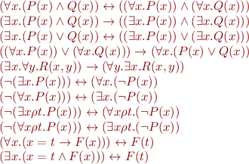
Logic as ars iudicandi
Leibniz’s Dream: “... if controversies were to arise, there would be no more need of disputation between two philosophers than between two accountants. For it would suffice for them to take their pencils in their hands and to sit down at the abacus, and say to each other: Calculemus.”
characteristica universalis

Slide 3
Logic as ars iudicandi
Improved ITP & ATP technology has led to success stories in mathematics …
Erdös-Selberg’s proof of the Prime Number Theorem (about 30,000 lines in Isabelle)
Proof of Four Color Theorem (60,000 lines in Coq)
Proof of the Jordan Curve Theorem (75,000 lines in HOL-Light).
Proof Kepler’s conjecture by Thomas Hales (> 100,000 lines of Isabelle and HOL-Light)
... and also in metaphysics
Automation of variants of Ontological Argument for the Existence of God [IJCAI 2016, ...]
Formalisation of Zalta‘s Pricipia-logico Metaphysica [submitted (arXiv preprint)]

Slide 4
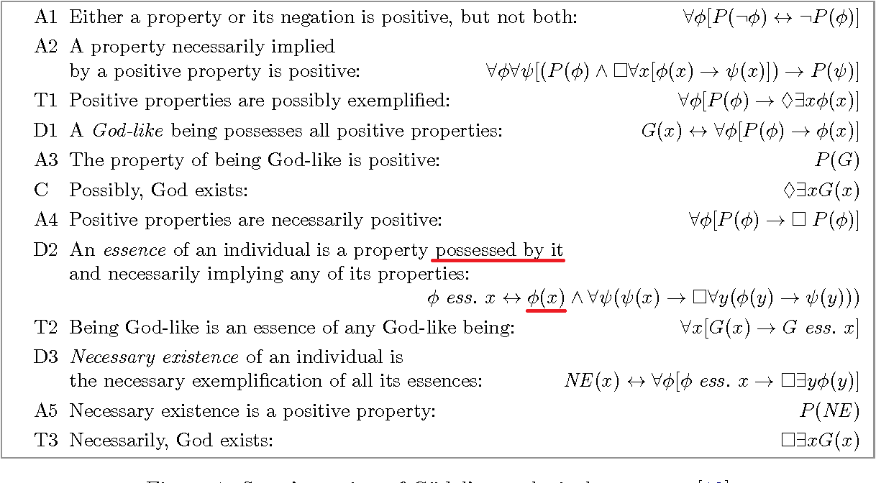
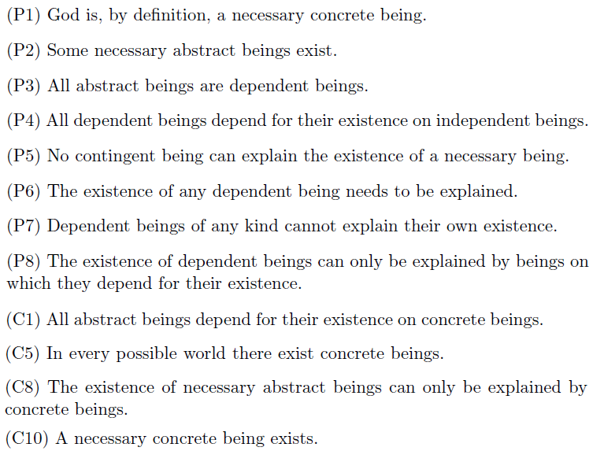
Computational Metaphysics
and many other variants ...
Gödel/Scott’s Ontological Argument
Lowe’s Modal Ontological Argument
[Benzmüller&Woltzenlogel-P., IJCAI, 2016]
[Fuenmayor&Benzmüller, Log.Univ., forthcoming]

Slide 5
Gödel‘s / Scott‘s Variants of the Ontological Argument

Slide 6
Gödel/Scott’s Ontological Argument
Kurt Gödel’s Variant
Higher Order Modal Logic: Quantification over properties and “possible worlds”
Positive properties (say, being honest) are necessarily so. I.e., an alternative world in which being honest is a bad thing would be inconceivable (see A4)
- Inconsistent Axioms
- Modal Collapse: No free will?
Dana Scott’s Variant
Similar to Gödel’s
Avoids inconsistency: Essential properties must be possessed by the individuals that feature them
Melvin Fitting’s Variant
Similar to Scott’s
Avoids Modal Collapse: uses intensional types and postulates that only extensional properties can be said to be positive or negative
Anthony Anderson’s Variant
Similar to Gödel’s
Avoids Modal Collapse by allowing
properties that are neither positive nor negative (see A1)

Slide 7
Lessons Learned
Analyzing Arguments in Metaphysics is
not only about proving facts by logical deduction (logic as ars iudicandi),
but also about understanding concepts better, highlighting inconsistencies, redundancies, implicit assumptions, etc. (logic as ars explanandi).

Slide 8
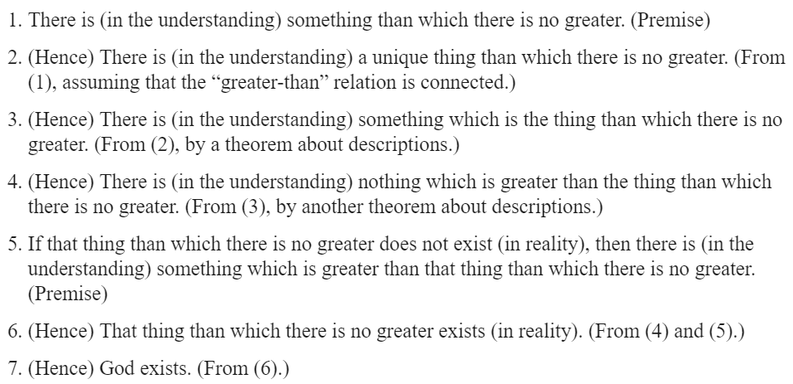
Logic as ars explanandi: Tackling the Problem of Formalization

Slide 9
Past Approaches to the Problem of Formalization
Project I: Development of an effective formalization procedure for natural language
Davidson’s Theory of Meaning (e.g. Logic of Actions and Events)
Chomsky’s Generative Grammar
Montague Universal Grammar (and followers: DRT, DPL, etc.)
Reflective Equilibrium Method (e.g. Peregrin and Svodoba 2017)
Project II: Develop criteria to evaluate formalization attempts
(e.g. is a given formula is an adequate formalization of some given natural language text)
Blau, U.: 1977, Die dreiwertige Logik der Sprache
Epstein, R. L.: 1990/4, The Semantic Foundations of Logic (Parts I - II)
Sainsbury, R. M.: 2001 (1991), Logical Forms.
Brun, G.: 2004, Die richtige Formel. Philosophische Probleme der logischen Formalisierung.
Baumgartner M. and Lampert T. (2008) Adequate formalization.

Slide 10
Inferentialist/Syntactic Criteria (Peregrin & Svodoba 2017)
Peregrin J. and Svoboda V. (2017) Reflective Equilibrium and the Principles of Logical Analysis:
Understanding the Laws of Logic. Routledge Studies in Contemporary Philosophy. Taylor & Francis, 2017.
Principle of Reliability (aka. Correctness):
Intuitively incorrect arguments should be logically incorrect. But: Verifying argument’s correctness involves all of the argument’s sentences (+ implicit premises): it is holistically determined.

Slide 11
Inferentialist (aka. Syntactic) Criteria (Peregrin & Svodoba 2017)
Principle of Ambitiousness (aka. Completeness):
Don’t play safe!
Always look for the inferentially most fruitful formalization, i.e. the one which renders as logically valid the highest number of intuitively correct arguments.

Slide 12
Inferentialist (aka. Syntactic) Criteria (Peregrin & Svodoba 2017)
Principle of Transparency:
Principle of Parsimony:

Slide 13
A Holistic View on Formalization
... much of the interest in logical form comes from an interest in logical geography: to give the logical form of a sentence is to give its logical location in the totality of sentences, to describe it in a way that explicitly determines what sentences it entails and what sentences it is entailed by. The location must be given relative to a specific deductive theory; so logical form itself is relative to a theory.
Donald Davidson - Action and Reaction (1970)

Slide 14
A Holistic View on Formalization
holistic, iterative, give-and-take enterprise
start with (tentative) candidate formalizations of some simple statements
use them as stepping stones for the formalization of the remaining statements
Example:
If, for some candidate formalization Φ of an statement S, we find out some logically correct (but intuitively incorrect) argument form involving Φ (as a counterpart of S), we may, instead of dropping the hypothesis that Φ is an adequate formalization of S, consider keeping the hypothesis at the cost of dispensing with formalizations of some of the other statements involved in the counterexample.
The formalizations of individual statements are holistically interconnected!

Slide 15
Criticism of Holistic Approaches
… that the same way that the whole is, of course, understood in reference to the individual, so too, the individual can only be understood in reference to the whole.
Friedrich Schleiermacher (1829)
Whole-and-Part Hermeneutic Circle:
Formalization of an argument sentence becomes tested by computing the logical validity of the whole (formalized) argument.
The formalization of whole argument depends (compositionally) on formalization of constituent sentences.
Underdetermination of the Theory of Choice (“Evidence alone cannot dictate the choice of a theory“)
The result of any adequacy test is dependent not only upon the choice of the particular formula that is tested, but also on the formulas selected as formalizations of other sentences appearing in the testing arguments (cf. Quine’s Indeterminacy of Translation)
Practical Unfeasibility
Even for the simplest argument it involves a search over a vast combinatoric of candidate formalizations, whose validity has to be tested at least several hundreds of times (also to account for logical pluralism).

Slide 16
Our Proposal: Integrate a Calculus Ratiocinator with existing Arsenal of Tools
NLP
Statistical Methods
Argumentation
Ontologies
DRT/DPL
Machine Learning
TAG/CCG
...

Slide 17
Our Proposal: Use ATP for Assessing Inferential Criteria

Slide 18
Our Proposal: Use ATP for Assessing Inferential Criteria
What do we need?
Datasets of intuitively correct arguments and inferences.
A “bootstrapping” mechanism to generate a (rough) initial formalization of the argument.
Mechanisms to generate further candidate formalizations (varying/merging previous ones).
And most importantly:
A mechanism to evaluate the inferential (and syntactical) adequacy of a candidate formalization:
ATPs and Model Checkers.

Slide 19
Can this ever lead to an effective formalization procedure?
We humans have never been able to replicate something more complicated than what we ourselves are, yet natural selection did it without even thinking. Don't underestimate the power of survival of the fittest. And don't ever make the mistake that you can design something better than what you get from ruthless massively parallel trial-and-error with a feedback cycle. That's giving your intelligence much too much credit!
Linus Torvalds

Slide 20
Massively Parallel, Trial-and-Error Approach to Logical Analysis with a Feedback Cycle
The problem of formalization becomes a combinatorial optimization problem.
Inferential and syntactic criteria of adequacy (cf. Peregrin and Svodoba 2017) can be used to define the utility/fitness function.
However, our main main selection criteria will be: a chosen formalization must validate the argument, avoid inconsistencies, avoid undesirable side-effects (cf. Principle of Charity).
For ‘tricky‘ philosophical arguments we can expect our selection criteria to prune most of the search tree.
Evaluation of our utility function (or selection criteria) takes some seconds?
Highly parallelizable?

Slide 21
The Computational Hermeneutics Approach
Repeat until reflective equilibrium
Determine logical and extralogical vocabulary -> Language analysis
Formalize argument in the spirit of the Principle of Charity. Iteratively do:
Argument reconstruction (in natural language): Add/remove premises, conclusions and inferential relations according to informal/intuitive criteria
Computer-supported (NLP, lexicons, ontologies, etc.)
Innovation mechanisms
Selection criteria
Knowledge-base of ‘correct’ arguments and inferences
Introduce definitions and axioms (logic of formalization may vary as a result)
Assess, e.g.:
- Is the argument logically valid?
- Does it ‘beg the question’?
- Does it have unwanted logical consequences?
Semantic embeddings of non-classical logics in HOL
How far have we deviated from the original argument? -> Language synthesis
Human- supported
Computer-supported (may require human intervention)
Computer-automated (ATPs, Model Finders, etc.)
Computer-supported

Slide 22
Questions?
UNILOG 2018 - Logical Correctness Workshop - June 23, 2018
David Fuenmayor
Free University Berlin
david.fuenmayor@fu-berlin.com
Christoph Benzmüller
University of Luxembourg and Free University Berlin
c.benzmueller@fu-berlin.com

Slide 23
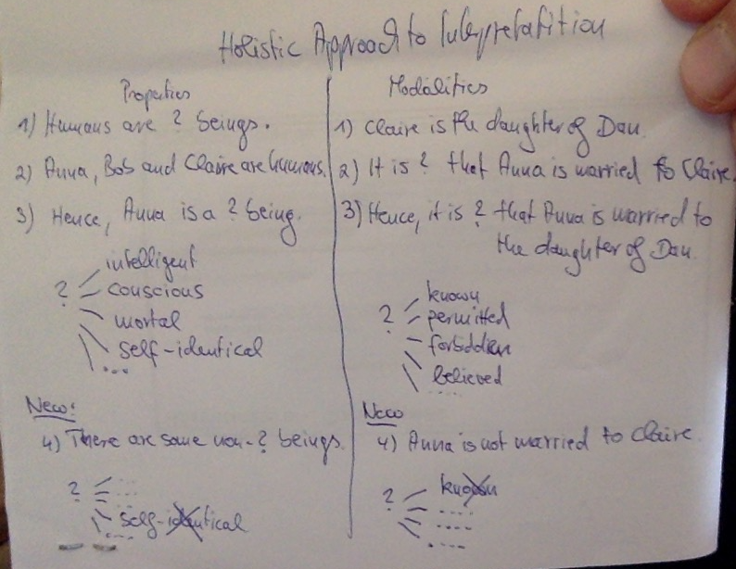
Holistic Approach to Interpretation

Slide 24
A Case Study: Lowe’s Modal Ontological Argument
(P1) God is, by definition, a necessary concrete being.
(P2) Some necessary abstract beings exist.
(P3) All abstract beings are dependent beings.
(P4) All dependent beings depend for their existence on independent beings.
(P5) No contingent being can explain the existence of a necessary being.
(P6) The existence of any dependent being needs to be explained.
(P7) Dependent beings of any kind cannot explain their own existence.
(P8) The existence of dependent beings can only be explained by beings on which they depend for their existence.
(C1) All abstract beings depend for their existence on concrete beings.
(C7) The existence of necessary abstract beings needs to be explained.
(C8) The existence of necessary abstract beings can only be explained by concrete beings.
(C9) The existence of necessary abstract beings is explained by one or more necessary concrete beings.
(C10) A necessary concrete being exists. (Necessary existence of God)
(D1) x is a necessary being := x exists in every possible world.
(D2) x is a contingent being := x exists in some but not every possible world.
(D3-4) The abstract/concrete distinction is exhaustive.
(D5) x depends for its existence on y := necessarily, x exists only if y exists.

Slide 25
Shallow Semantic Embeddings
(D1) x is a necessary being := x exists in every accessible possible world.
(D2) x is a contingent being := x exists in some but not every accessible possible world.
Enabling Technique: Shallow Semantic Embedding of Modal Logic in HOL.
Modal operators and quantifiers are embedded as constants of a meta-language (Isabelle/HOL).
More on semantic embeddings:
Benzmüller, C. and Paulson, L., Quantified Multimodal Logics in Simple Type Theory, Logica Universalis (Special Issue on Multimodal Logics) 7(1) (2013) 7-20.

Slide 26
Existence, Contingentism and Actualist Quantification
(D1) x is a necessary being := x exists in every accessible possible world.
(D2) x is a contingent being := x exists in some but not every accessible possible world.
Problem of Existence: We commit to Contingentism (instead of Necessitism).
We need to restrict the domain of quantification at every world -> Actualist Quantification -> Varying Domains

Slide 27
Choosing a Logic for Formalization
(D1) x is a necessary being := x exists in every accessible possible world.
(D2) x is a contingent being := x exists in some but not every accessible possible world.
We have just fixed our logic: (Free) Quantified Modal Logic (K).
We can refer to non-actual objects
No constraints on accessibility relation

Slide 28
Abstractness and Concreteness
(D3-4) The abstract/concrete distinction is exhaustive.
(P2) Some necessary abstract beings exist.
◽Exists(x)

Slide 29
Ontological Dependence
(P3) All abstract beings are dependent beings.
(P4) All dependent beings depend for their existence on independent beings.
dependent being
A depends for its existence on B
independent being

Slide 30
Metaphysical Explanation
(P5) No contingent being can explain the existence of a necessary being.
(P6) The existence of any dependent being needs to be explained.
(P7) Dependent beings of any kind cannot explain their own existence.
(P8) The existence of dependent beings can only be explained by beings on which they depend for their existence.
A explains the existence of B
existence of A is explained

Slide 31
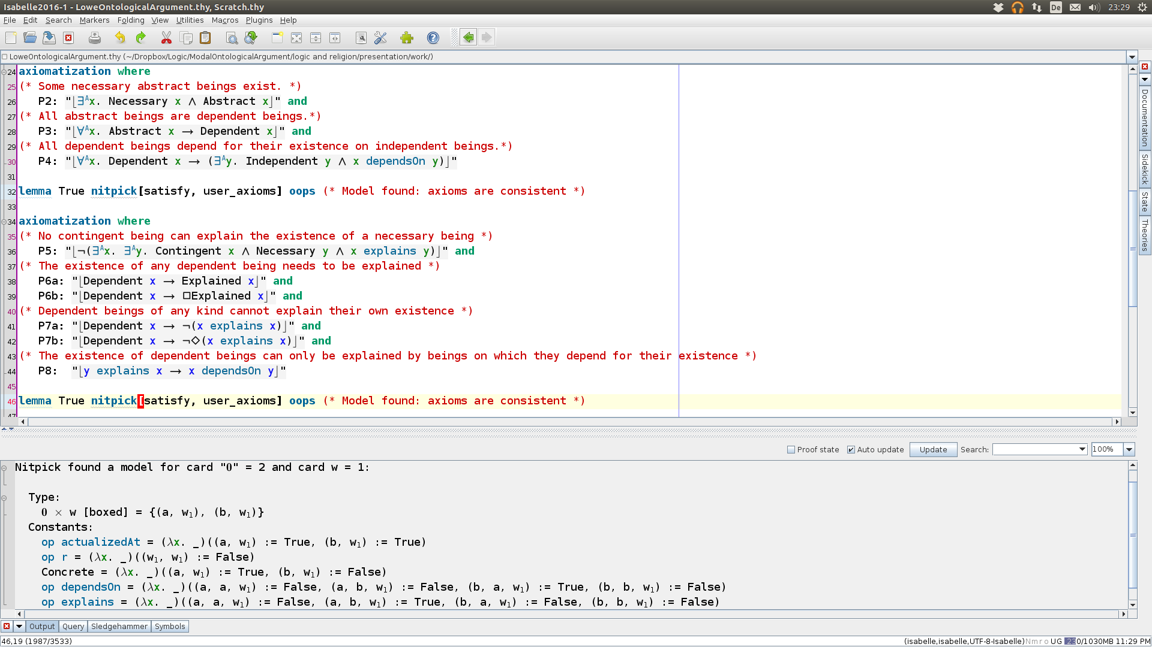
Formalization of Premises

Slide 32
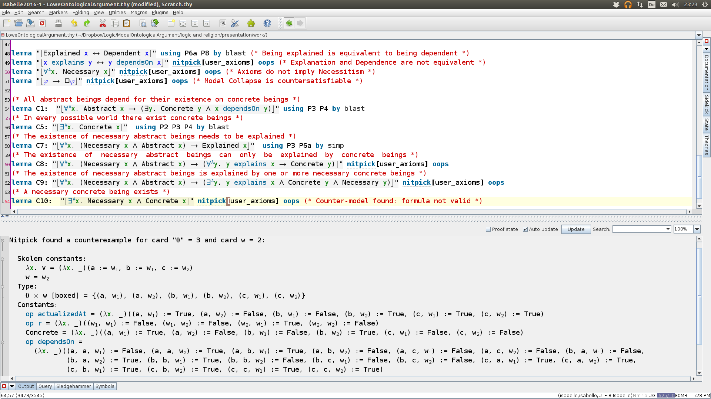
Formalization of Conclusions

